Slide 1

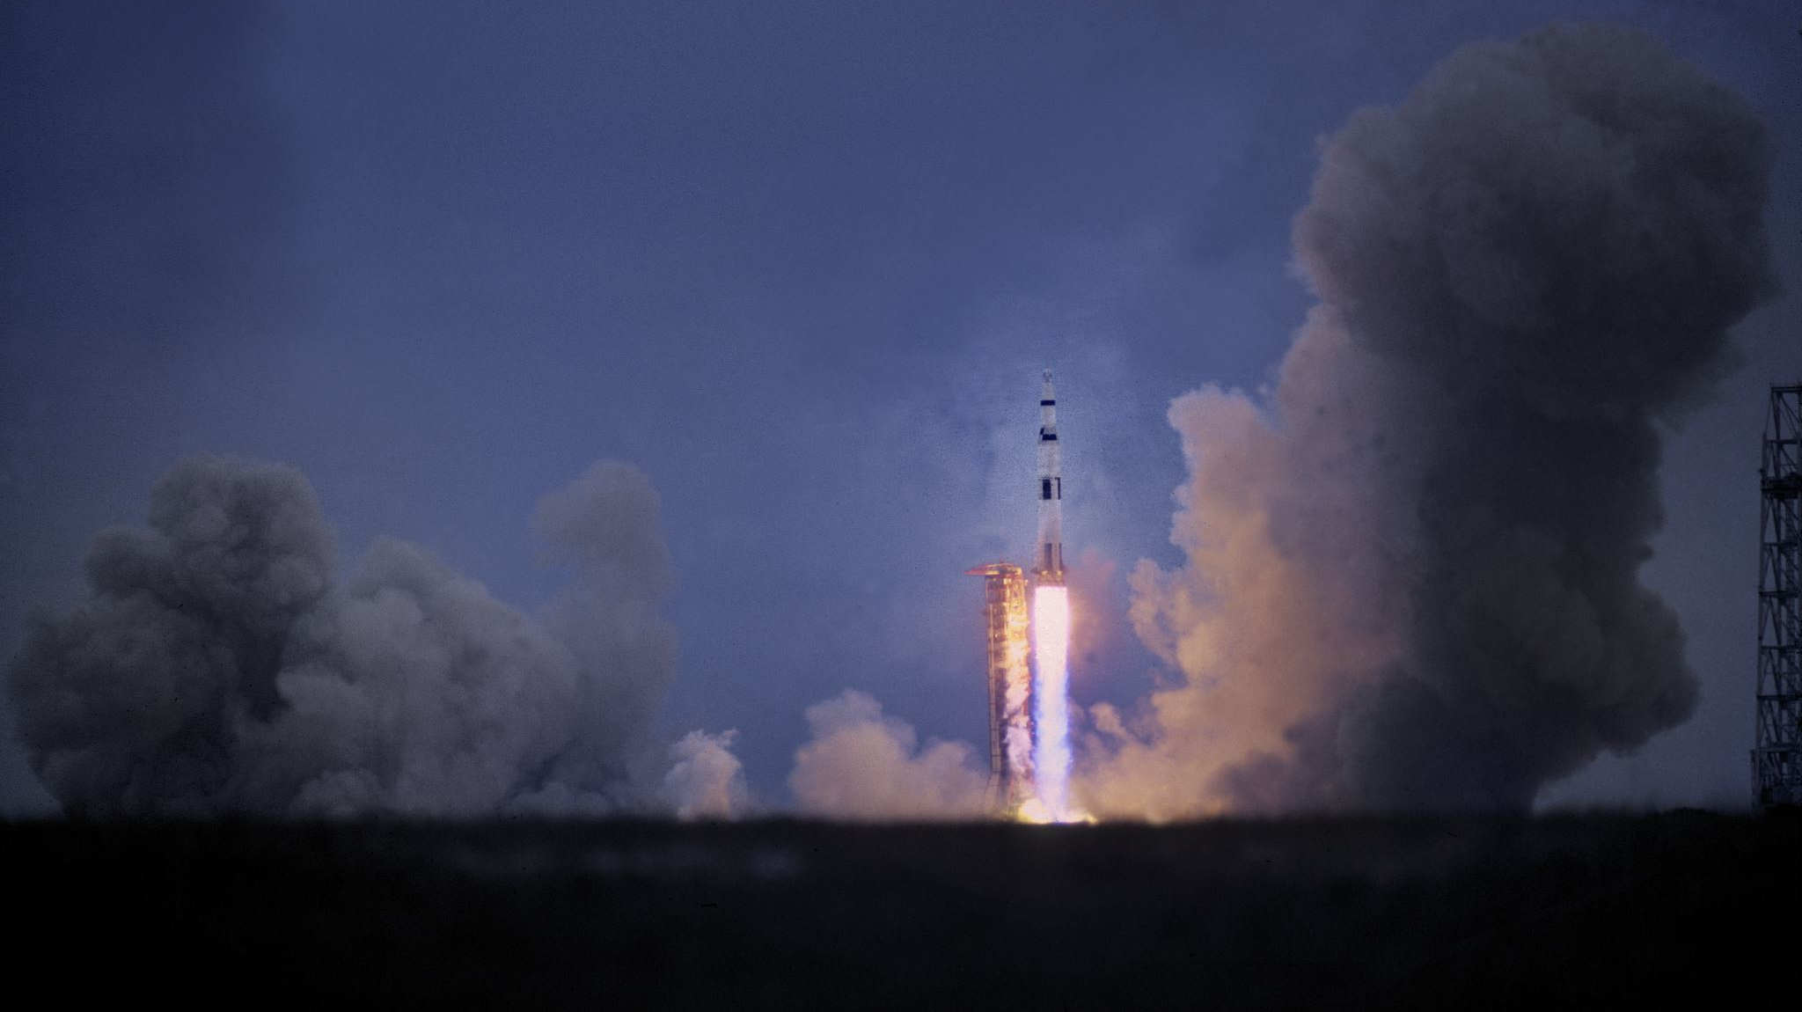
Julio Ribeiro Barros
International Student at EMU, From Brazil, Major Mechanical Engineer.

Slide 2
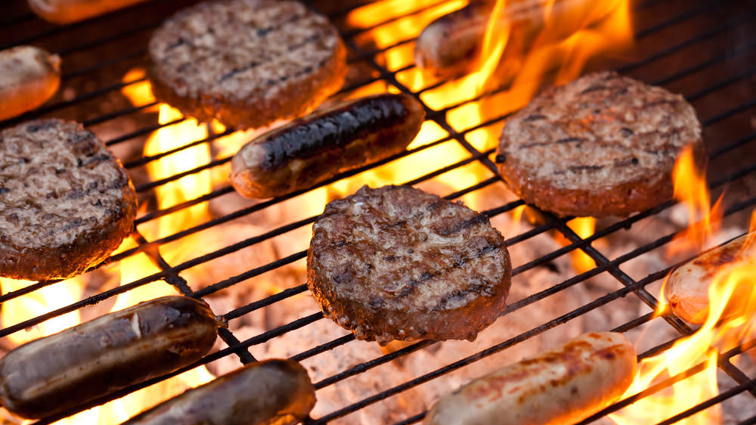
Brazilian Barbecue
September 8, 2019 5:00pm - Midnight
Address: 7058 Grass Rd, Saline, MI 48176
Hosted By: Julio Ribeiro Barros (734) 249-2768
This Photo by Unknown Author is licensed under CC BY

